Slide 1
Addressing issues

Slide 2
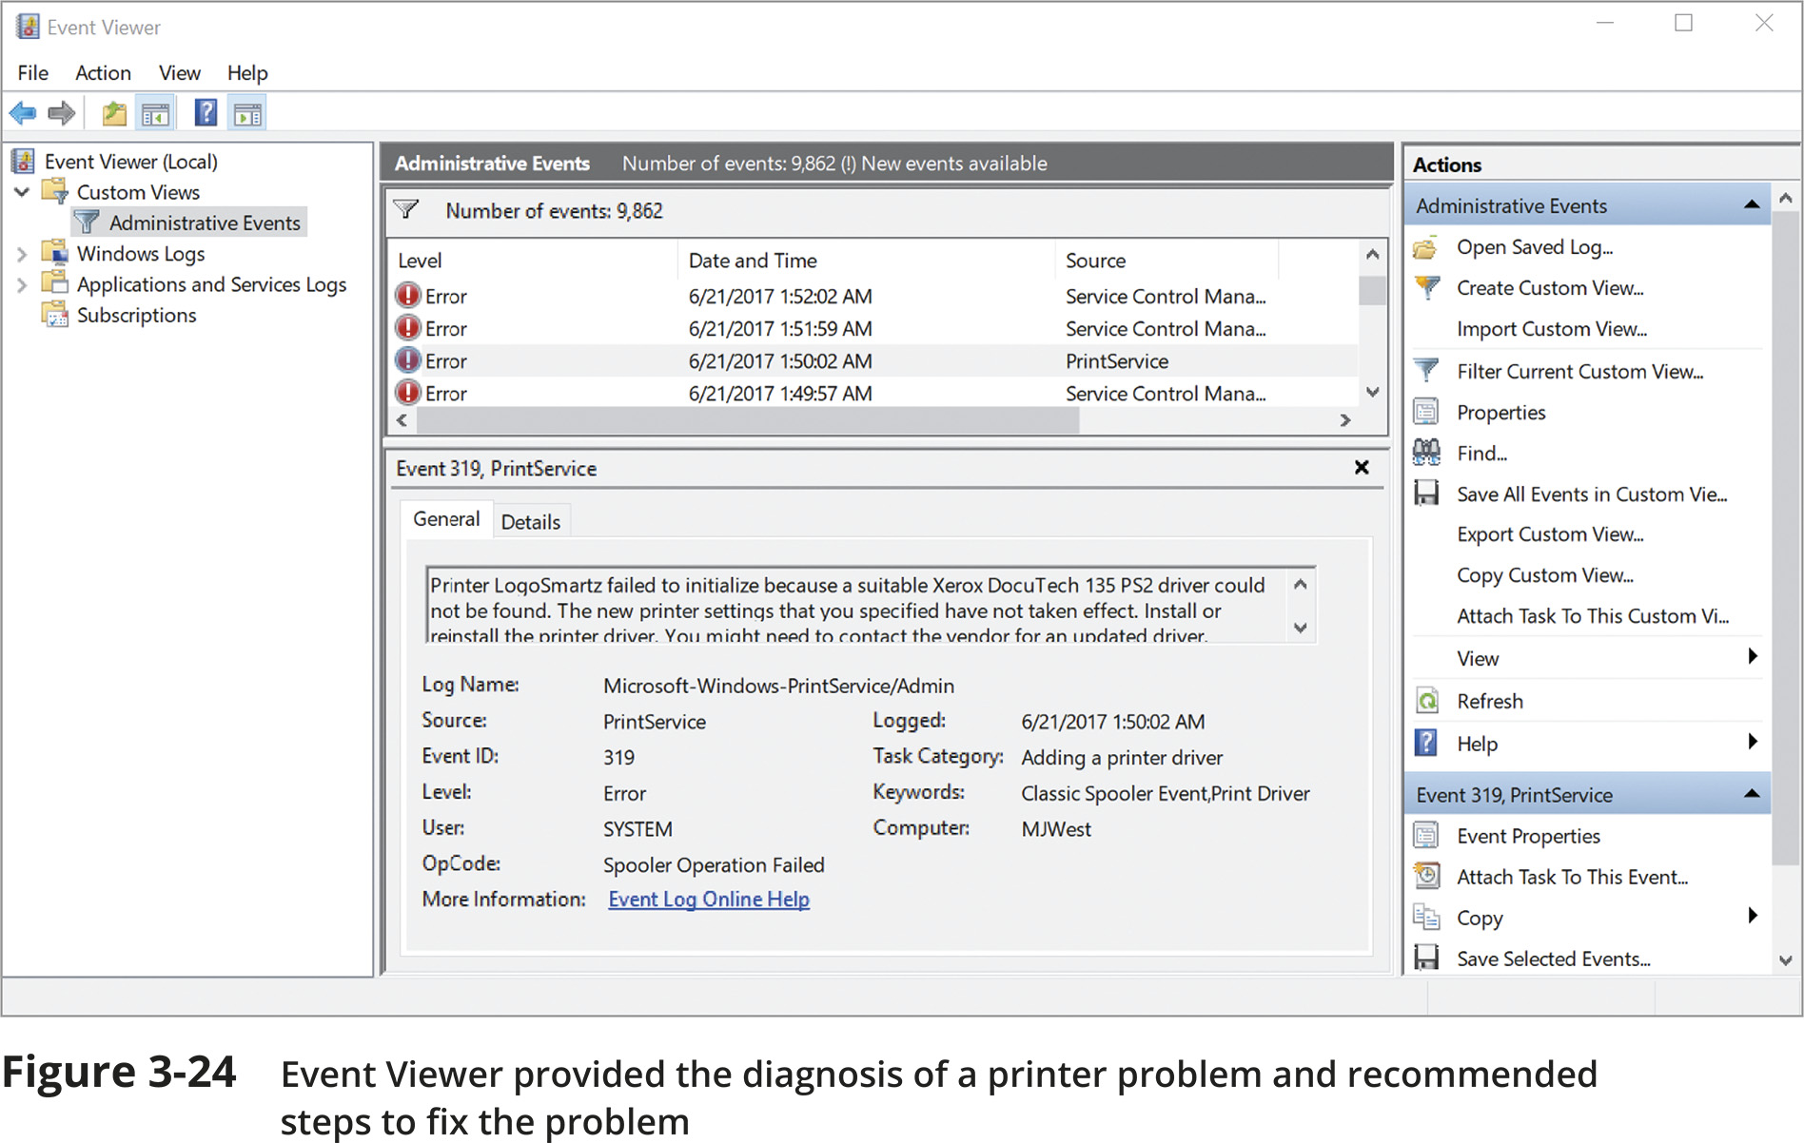
Troubleshooting Address Problems

Slide 3
Troubleshooting Tools (1 of 8)
Command-line tools are a great resource to troubleshoot network problems
ping (Packet Internet Groper) utility is used to verify that TCP/IP is:
Installed
Bound to the NIC
Configured correctly
Communicating with the network
The ping utility sends out a signal called an echo request to another device (request for a response)
The other computer responds in the form of an echo reply
ICMP (Internet Control Message Protocol) is the protocol used by the echo request/reply to carry error messages and information about the network

Slide 4
Troubleshooting Tools (2 of 8)
IPv6 networks use a version of ICMP called ICMPv6
ping6 – on Linux computers running IPv6, use ping6 to verify whether an IPv6 host is available
ping -6 – on Windows computers, use ping with the -6 switch to verify connectivity on IPv6 networks
For the ping6 and ping -6 commands to work over the Internet, you must have access to the IPv6 Internet

Slide 5
Troubleshooting Tools (3 of 8)
The ipconfig command shows current TCP/IP addressing and domain name information on a Windows computer
Use ipconfig/all to see a more complete summary of TCP/IP addressing information

Slide 6
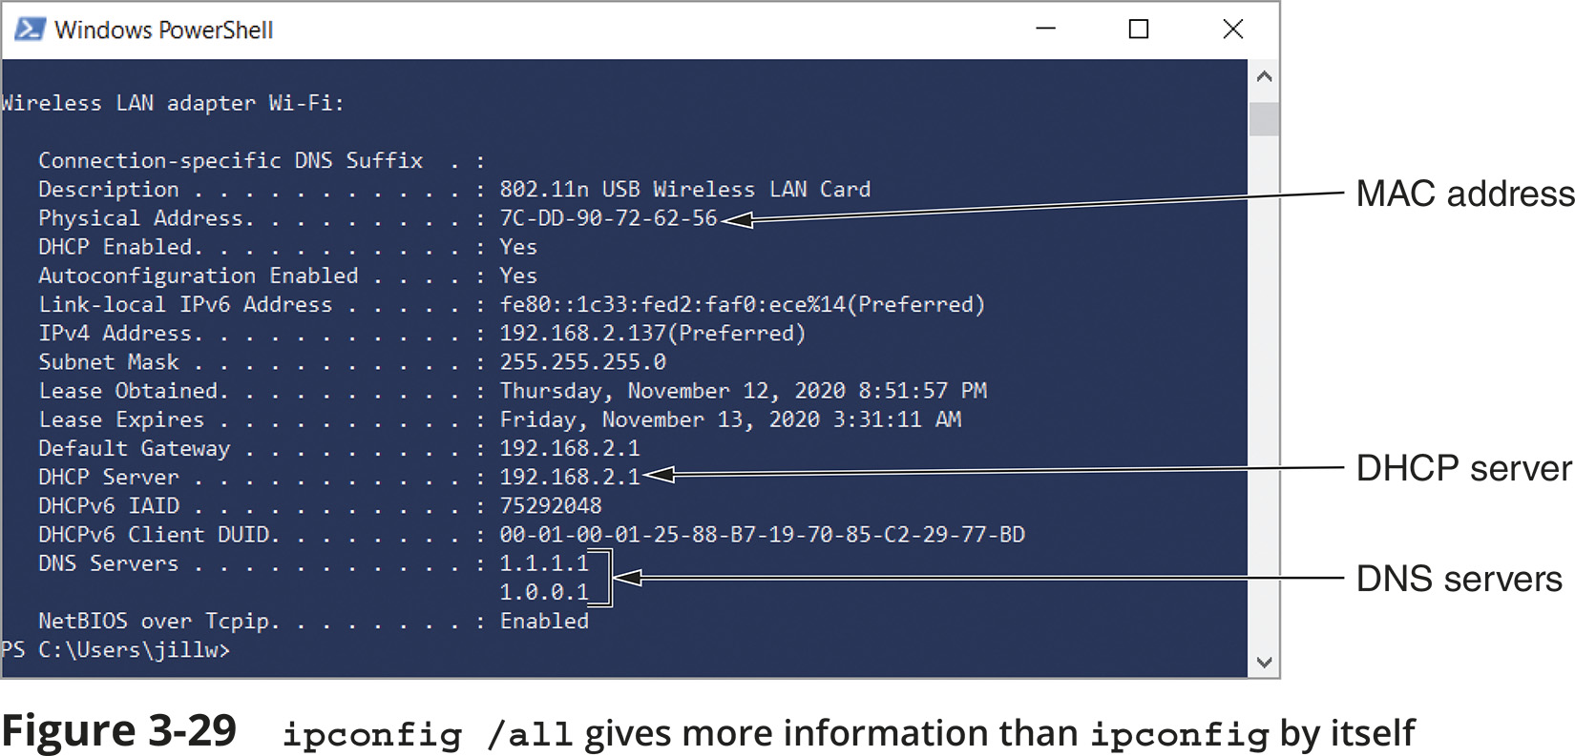
Troubleshooting Tools (4 of 8)

Slide 7
Troubleshooting Tools (5 of 8)
Use the ip utility to view and manage TCP/IP settings
The ip utility is only available on UNIX and Linux systems
Any ip commands that change the state of a link require elevated privileges
This is accomplished by logging in as the root user or by temporarily elevating the current user's privileges with the sudo (superuser do) command
ifconfig is a similar utility used to view and manage TCP/IP settings
If your Linux or UNIX system provides a GUI
Open a shell prompt, then type ifconfig

Slide 8
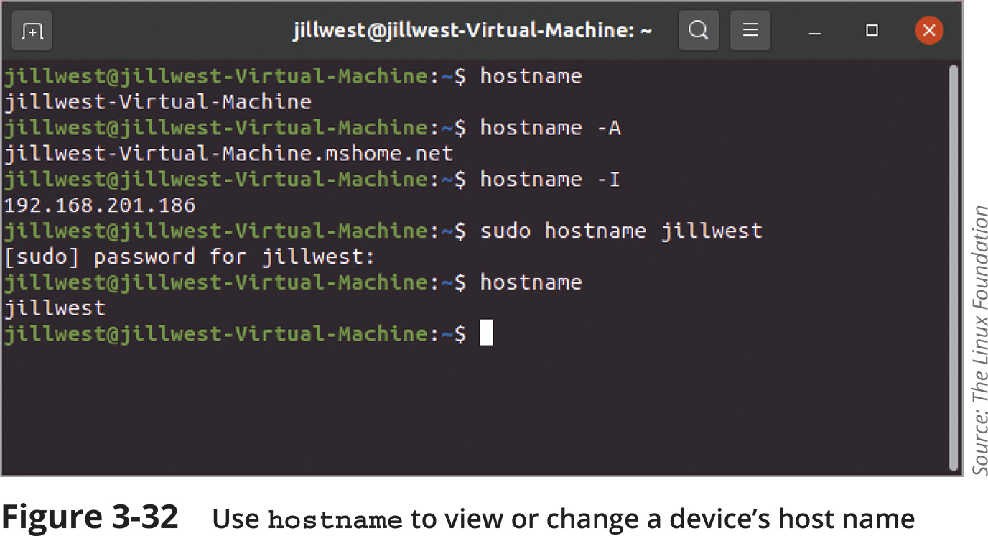
Troubleshooting Tools (6 of 8)

Slide 9
Troubleshooting Tools (7 of 8)
The nslookup (name space lookup) utility allows you to query the DNS database from any computer on a network
To find the host name of a device by specifying its IP address, or vice versa
It is useful for verifying a host is configured correctly or for troubleshooting DNS resolution problems
Reverse DNS lookup - to find the host name of a device whose IP address you know
nslookup 69.23.208.74

Slide 10
Troubleshooting Tools (7 of 8)
The nslookup utility is available in two modes:
Interactive - to test multiple DNS servers at one time
Noninteractive - test a single DNS server
You can change DNS servers from within interactive mode with the server subcommand and specifying the IP address of the new DNS server
To exit nslookup’s interactive mode, enter exit

Slide 11
Troubleshooting Tools (8 of 8)
The dig (domain information groper) utility is available on Linux and macOS
Provides more detailed information than nslookup and uses more reliable sources of information to output its results
Use dig to query DNS nameservers for information about host addresses and other DNS records
An IP scanner can be used to gather information about all devices connected to a network

Slide 12
Common Network Issues (1 of 2)
Incorrect time
Check a domain computer’s time source from a Command Prompt window by entering w32tm /query /source
DHCP Issues
If you are getting DHCP errors or if multiple clients are having trouble connecting to the network, try the following:
Check the settings on your DHCP server
Make sure the DHCP scope is large enough to account for the number of clients the network must support
Consider implementing a shorter lease time on larger networks

Slide 13
Common Network Issues (2 of 2)
Network Connection Configuration Issues
Common configuration errors:
Incorrect IP address
Duplicate IP address
Incorrect subnet mask
Incorrect gateway
Incorrect DNS or DNS issues
When a computer is struggling to establish a network connection
Check its TCP/IP configuration settings
If the computer is not obtaining an IP address and related information from a DHCP server
Static settings might be using the wrong information
Try switching to DHCP

